Slide 1

Data Analytics: Understanding Customers and Predicting Profitability
Axita gupta, Andres Saucedo, Jason Rodriguez & Steven Herrera

Slide 2
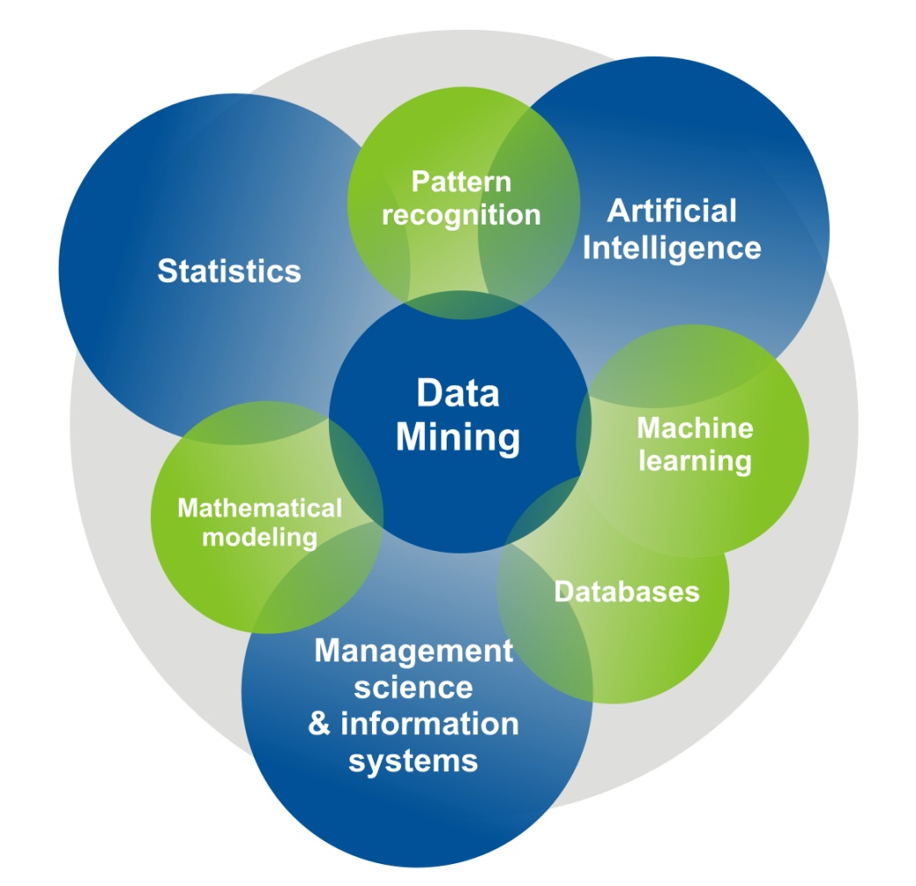
What is Data Mining
Process used by companies to turn raw data into useful information
Computer based methods applied to large and complex databases – to eliminate randomness and discover hidden patterns using different techniques of visualization, reduction of dimensionality, classification, and construction of models
Data mining can be used by corporations for everything from learning about what customers are interested in or want to buy to fraud detection and spam filtering.

Slide 3
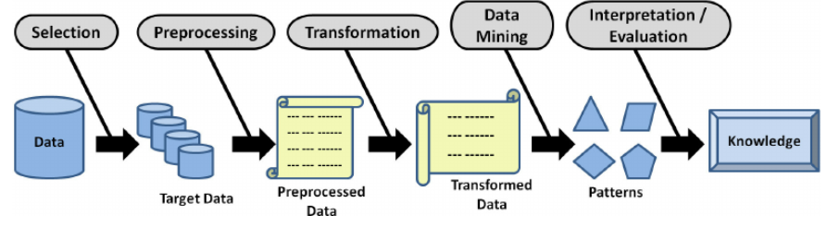
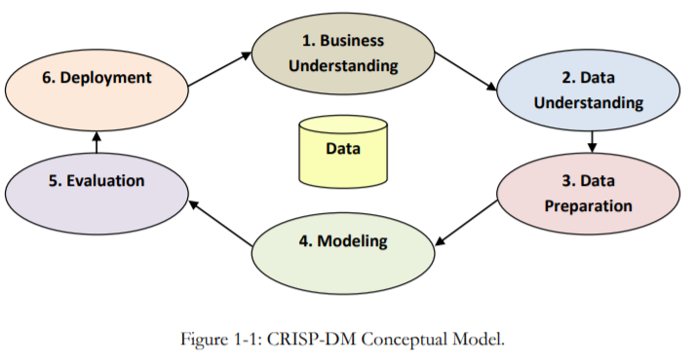
Data Mining Process
Stages: knowledge discovery in databases (KDD) process
Selection
Pre-processing
Transformation
Data mining
Interpretation/evaluation.
Cross Industry Standard Process for Data Mining (CRISP-DM)
Business understanding
Data understanding
Data preparation
Modeling
Evaluation
Deployment
or a simplified process such as (1) Pre-processing, (2) Data Mining, and (3) Results Validation.
Gullo, Francesco. (2015)

Slide 4
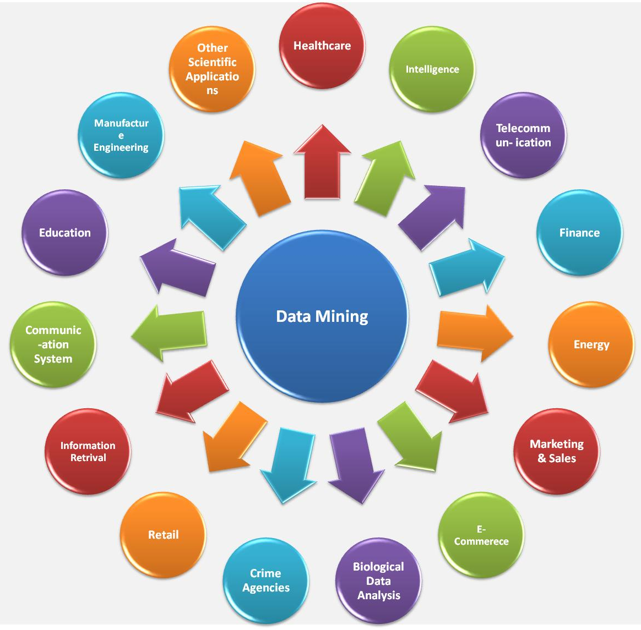
Uses/ Application of Data Mining
Data Mining methods are applicable in wide range of sectors Example Finance, Healthcare, Intelligence, Telecommunication, Energy, Retail, E-commerce, Supermarkets, Crime Agencies, Businesses Benefit from data mining and other sectors
Data Mining can help in:
Automated Prediction of Trends and Behaviors
Automated Discovery of Previously Unknown Patterns
Examples of Data Mining Applications
Banks and financial institutions - to find probable defaulters
Helps advertisers to push the right advertisements to the internet
Retail malls and grocery stores people used. This helps to arrange and keep most sellable items in the most attentive positions.

Slide 5
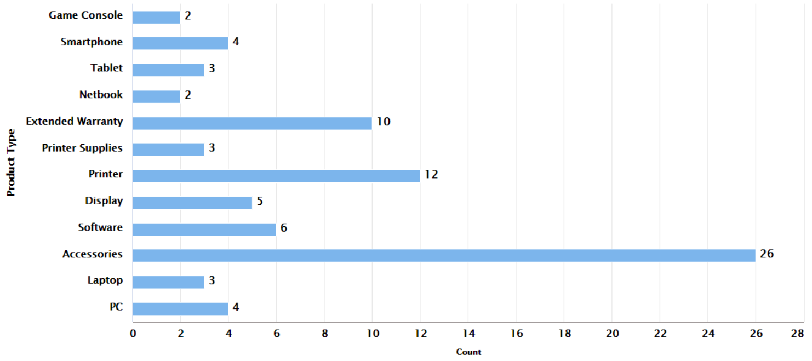
Task 2 - Introduction
Goal : Help Blackwell sales team in predicting profitability of the potential new products & short listing top 5 products
Main Purpose - Predict Sales Volume & Estimate Profitability of New Products
Assumption - Certain attributes are associated with highly successful (current) products and, therefore, any potential new products that also have these attributes will be similarly successful, regardless of if a potential new product is similar to an existing product or not.
Method: Regression Analysis using k-NN (k Nearest Neighbor) and SVM (Support Vector Machine) and GBT (Gradient Boosting Trees)
80 existing products data have been analyzed in this task using CRISP-DM
Total 80 existing products by product type
CRISP-DM conceptual model
(Cross Industry Standard Process – Data Mining)

Slide 6
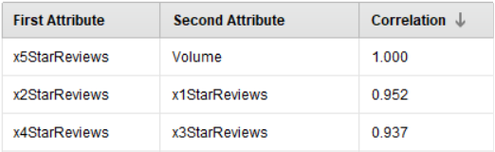
Task 2 - Existing Product Data & Pre-processing
Data Cleaning –
Raw data was prepped by removing any special characters and spaces from attribute labels (total 17 attributes).
Product Type (polynominal) and Best sellers rank (contains missing data) were removed from regression analysis
Sales Volume – Dependent Variable
Data Pre-processing –
Normalization – all attributes normalized to bring them on same scale (0 to 1) using Range – transformation
Feature Selection using Correlation Matrix
1 star and 3 star review attributes were removed from analysis because correlation matrix > 0.90
Top 5 existing products based on total sales volume, profit margin, and price
Correlation Matrix

Slide 7
Task 2 - Analyzing Data Training, Optimizing and Selecting Best Fit Model
Training & Testing Model:
k-NN (k Nearest Neighbor) - Measures the distance between new observations and the nearest k training instances to make predictions. It is based on feature similarity
SVM (Support Vector Machine) - This algorithm tries to fit error within a certain threshold. Kernel Type C – Complexity Constant (sets the tolerance for misclassification) are the two parameters tuned for optimization of this model.
GBT (Gradient Boosting Trees) - It generates prediction model typically in form of decision trees Two GBT parameters learning rate and no. of trees have been tuned for optimizing this model
Performance Metrics:
Root Mean Square Error (RSME): Measures difference between values predicted by model and the observed values
Squared Correlation (R²): Measure of variance i.e., to what extent variance in one variable explains variance in second variable. It can measure anywhere from 0 to 1. Acceptable range is between 0.8 -0.9.
Support Vector Machine (SVM) with C (complexity constant) = 54 and Kernel Type “DOT” yields least level of comparative error RMSE = 330.102 +/- 202.226 and R² = 0.872 +/- 0.152.
Therefore, SVM has been choosen and used as best fit model

Slide 8
Task 2 - Results & Conclusion Predicting Sales Volume & Estimating Portability
Results:
SVM best fit model was applied to 17 new products to Predict Sales Volume and Estimate Profitability
Profitability = estimated volume × profit margin × price
Conclusion:
Out of 17 products – based on our analysis product # 171, 187,172, 176, and 186 are the products with highest profitability that we would like to recommend to Blackwell’s sale team.

Slide 9
References
Gullo, Francesco. (2015). From Patterns in Data to Knowledge Discovery: What Data Mining Can Do. Physics Procedia. 62. 18–22. 10.1016/j.phpro.2015.02.005.
https://data-flair.training/blogs/data-mining-applications/

